Slide 1
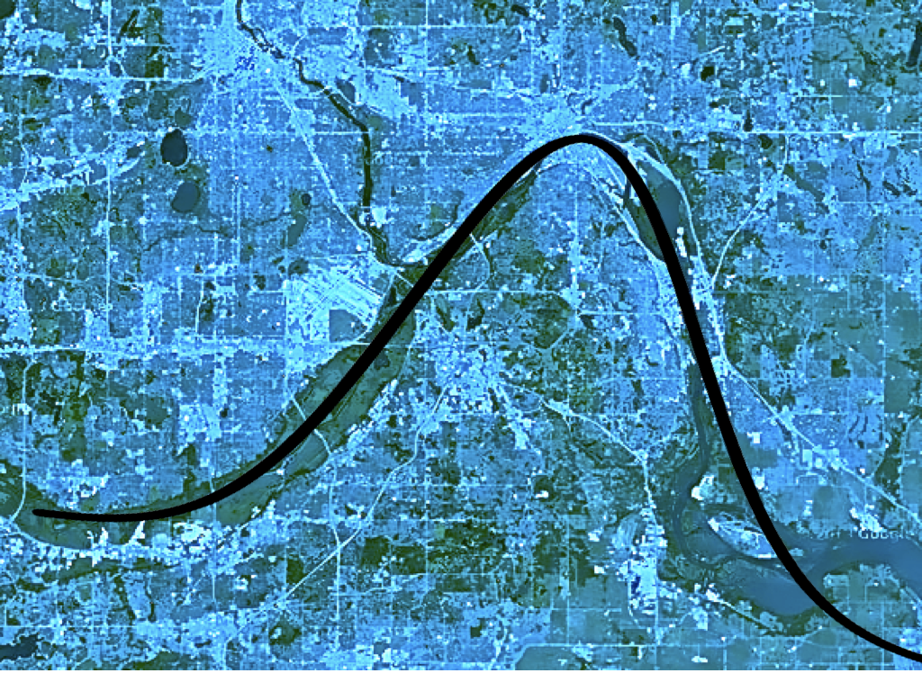
Authoring & Utilizing Open Source,
Reproducible Statistics/Data Science Textbooks
Alicia Johnson, Macalester College

Slide 2
Authoring & Utilizing Open Source,
Reproducible Statistics/Data Science Textbooks
Alicia Johnson, Macalester College

Slide 3
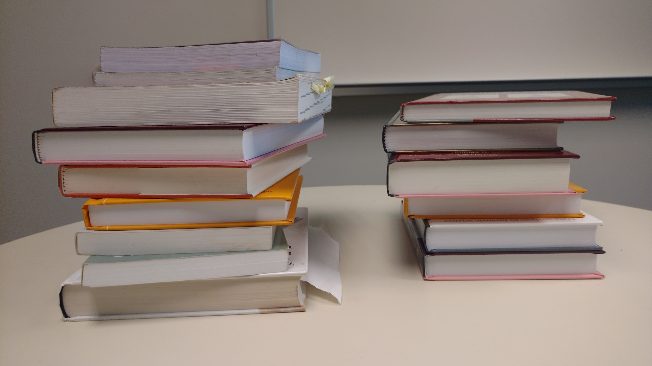
2013 office recreation

Slide 4

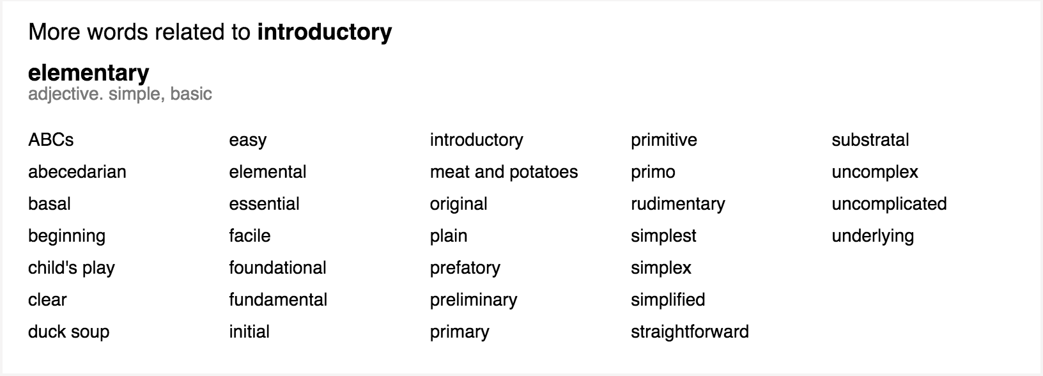

Slide 5

BUILD

Slide 6
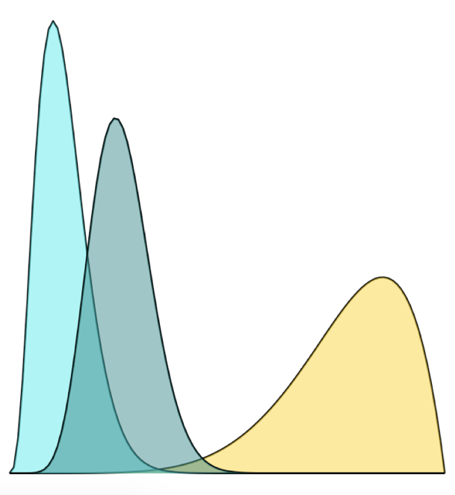
BUILD
DEVELOP

Slide 7

BUILD
DEVELOP
DISTRIBUTE

Slide 8
BUILD
DEVELOP
DISTRIBUTE
reflect current best practices in stat ed &
modern data science workflow

Slide 9


Slide 11
A raw R Markdown (Rmd) file
A recent fivethirtyeight.com article asked “What do men think it
means to be a man?” **Q: How much have you heard about the
#MeToo movement?**
```{r echo = FALSE}
# Load data
survey <- read.csv("https://raw.github....masculinity-survey.csv")
# Plot survey results
ggplot(survey, aes(x = Response, y = Percent)) +
geom_col() +
coord_flip()
```

Slide 12
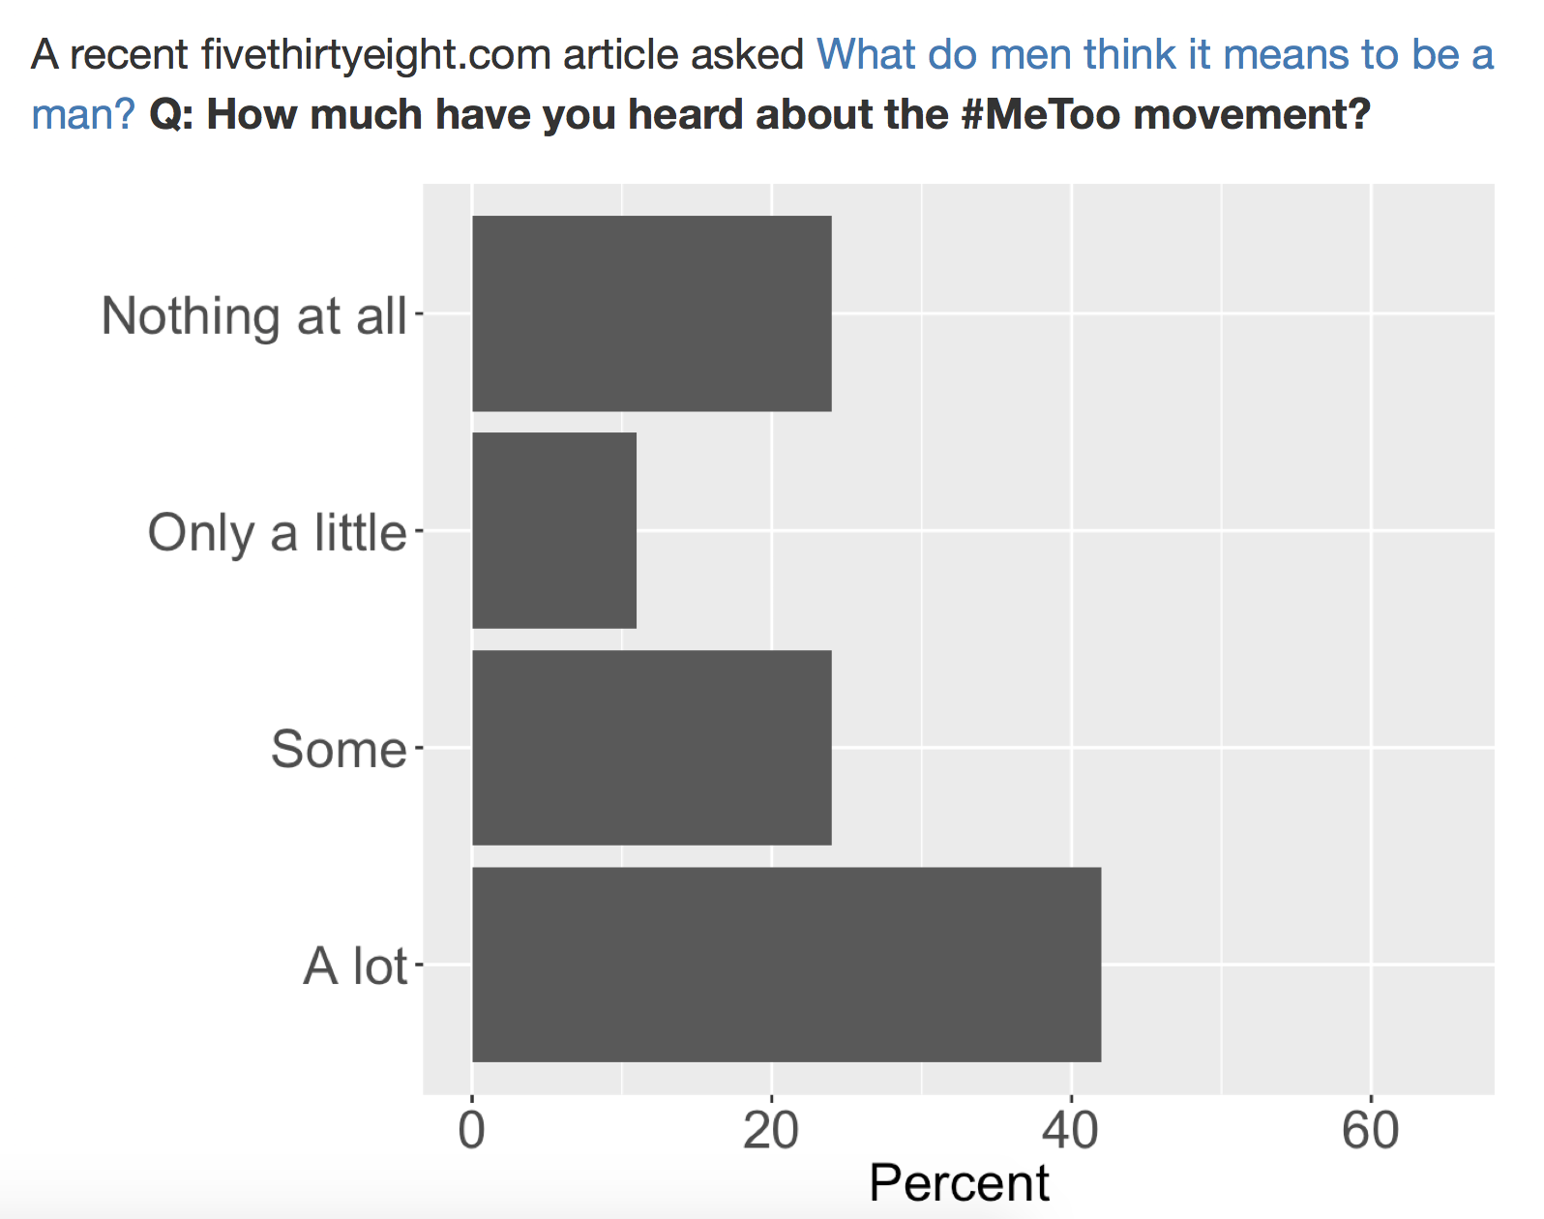
A compiled R Markdown (Rmd) file

Slide 13
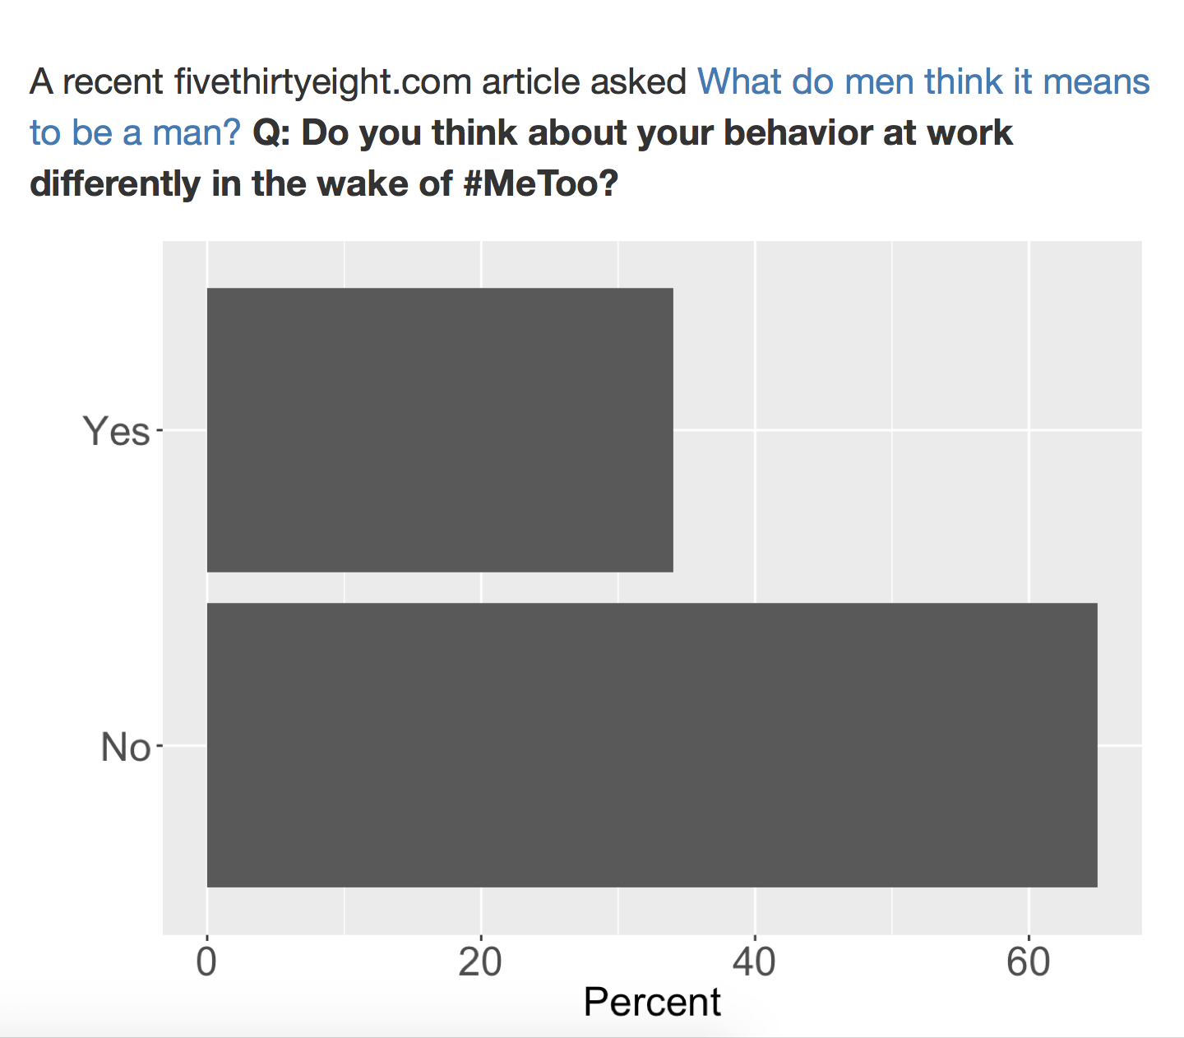
A compiled R Markdown (Rmd) file

Slide 14
A common bookdown workflow
Create
chapter n
chapter 2
chapter 1
Rmd

Slide 15
A common bookdown workflow
Create
Compile
chapter n
chapter 2
BOOK
chapter 1
Rmd

Slide 16
A common bookdown workflow
Create
Compile
Output
chapter n
html
epub
pdf
word
chapter 2
BOOK
chapter 1
Rmd

Slide 17
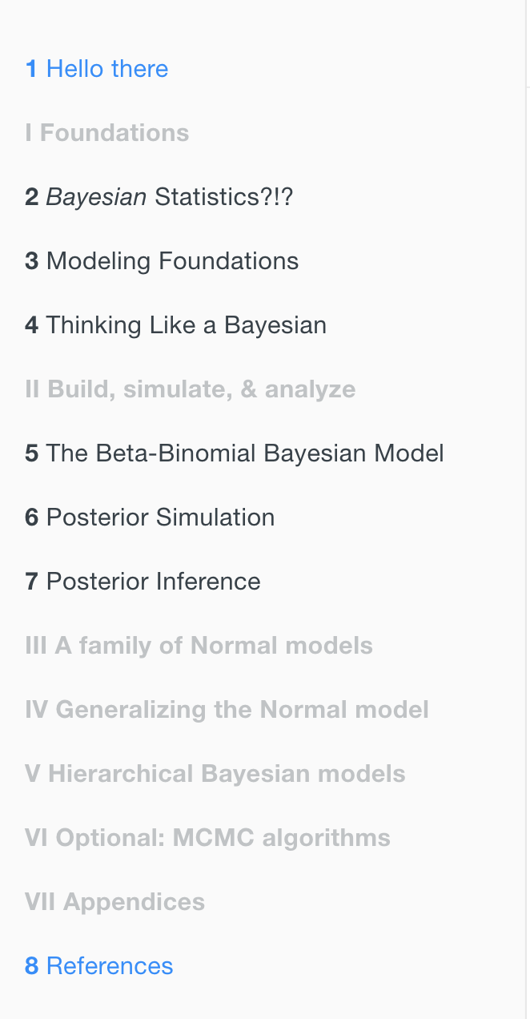
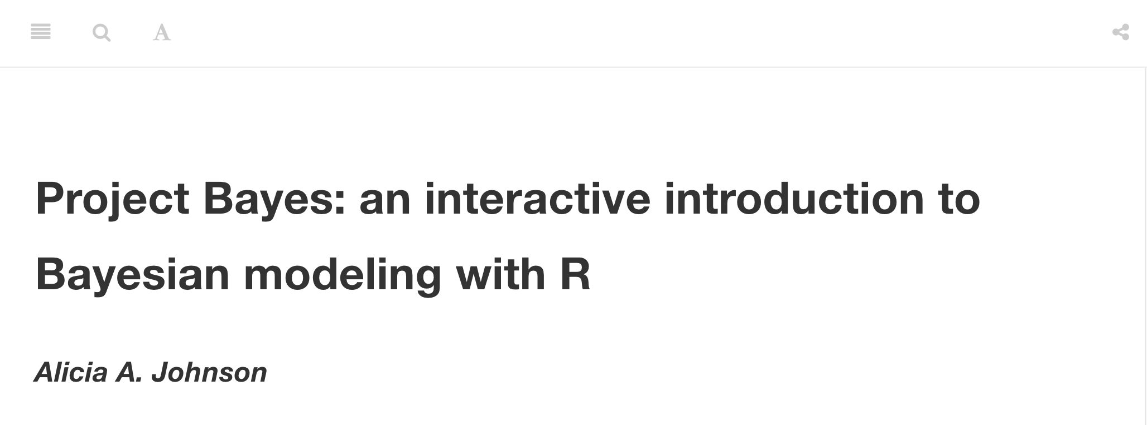
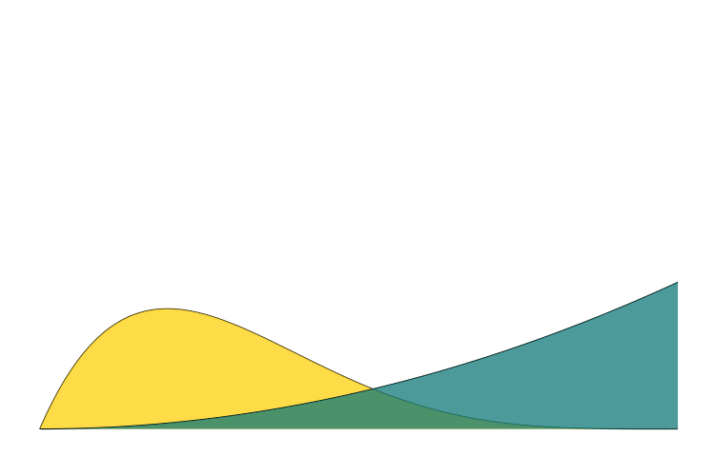

Slide 18
DEVELOP
reflect modern best practices in statistics education

Slide 19
DEVELOP
reflect modern best practices in statistics education
emphasize conceptual understanding!
promote data-driven inquiry!
incorporate technology (eg: R)!

Slide 20
DEVELOP
reflect modern best practices in statistics education
emphasize conceptual understanding!
promote data-driven inquiry!
incorporate technology (eg: R)!
foster active learning!

Slide 21
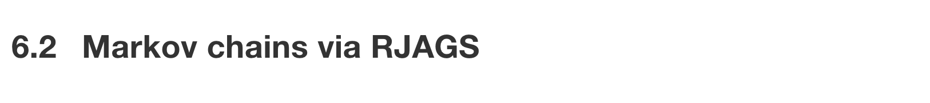
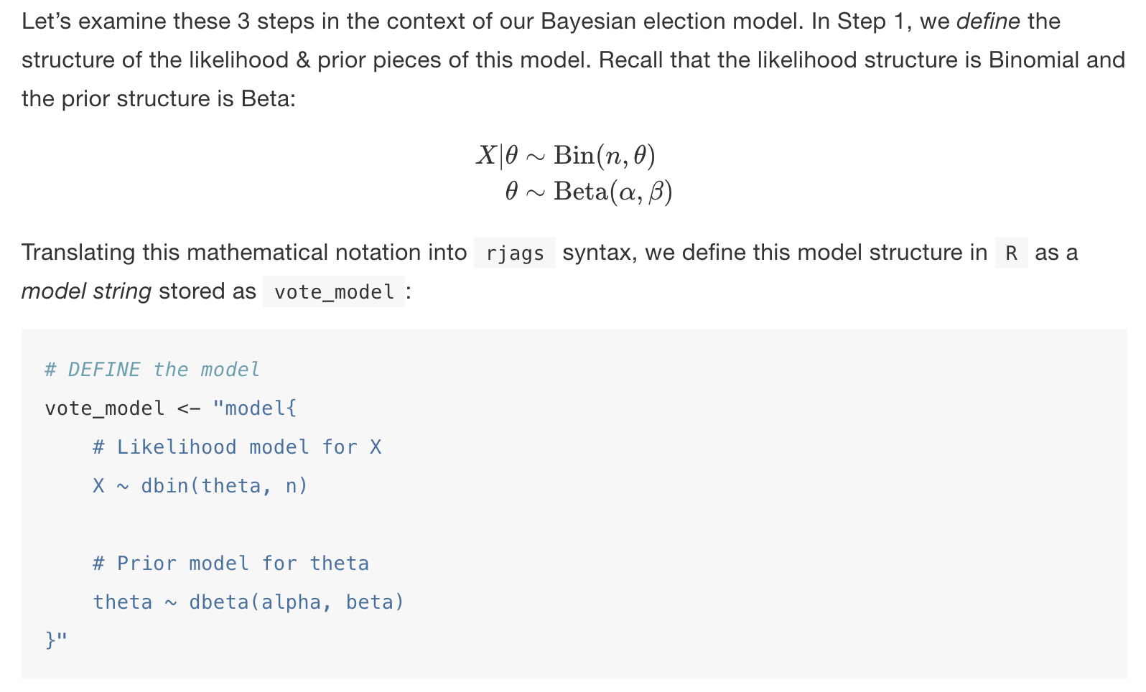
Learn by doing: R

Slide 22
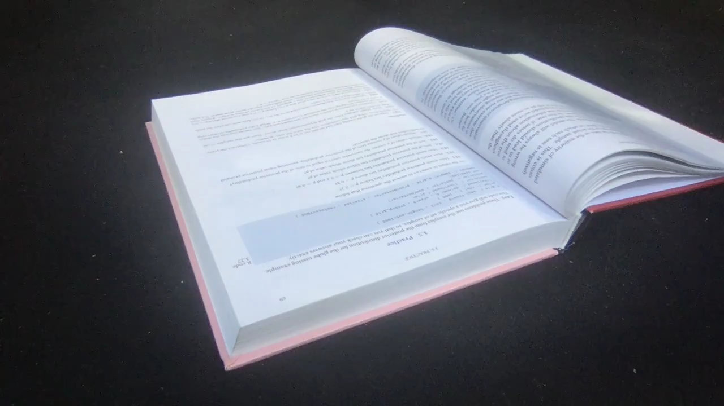
Try to learn by doing...

Slide 23
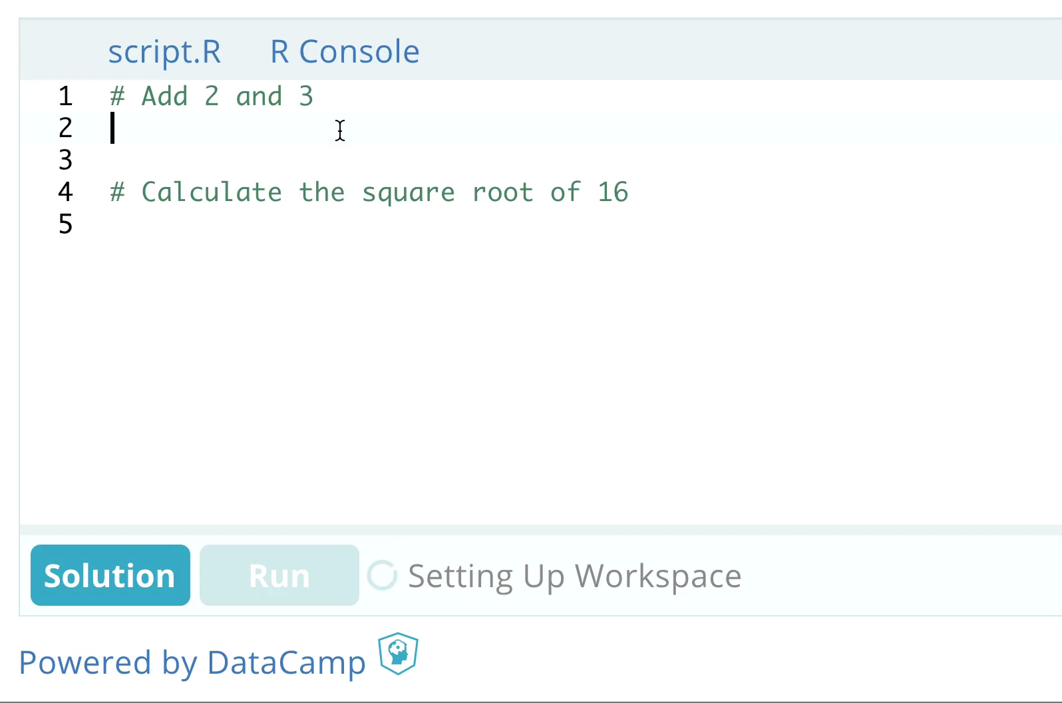
Really learn by doing: DataCamp Light

Slide 24
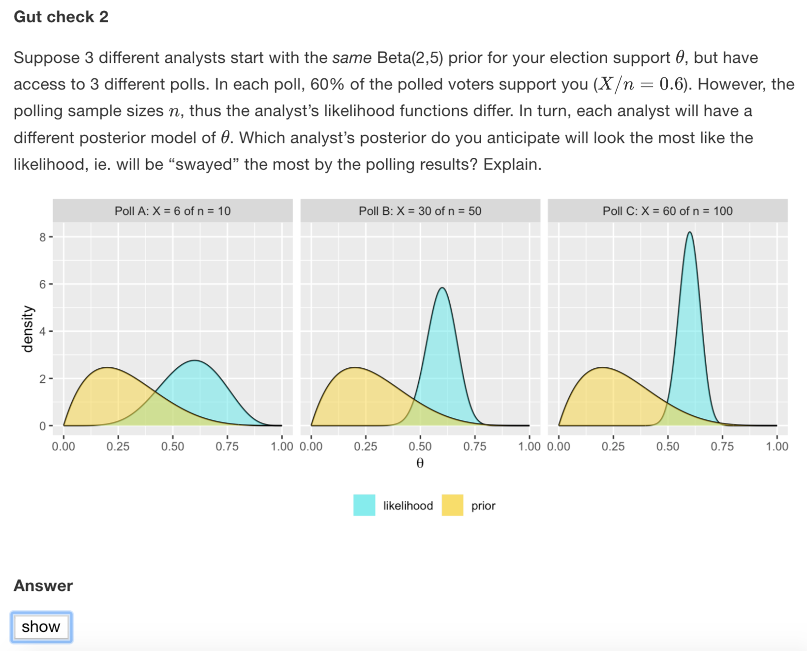
Stop and think: code folding

Slide 25
Stop and think: code folding

Slide 26
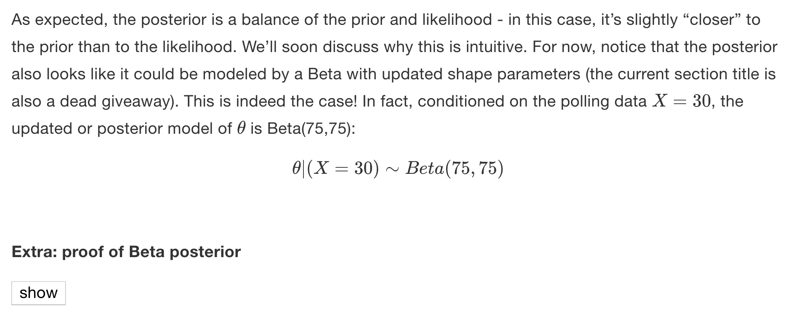
Stop and think: code folding

Slide 27
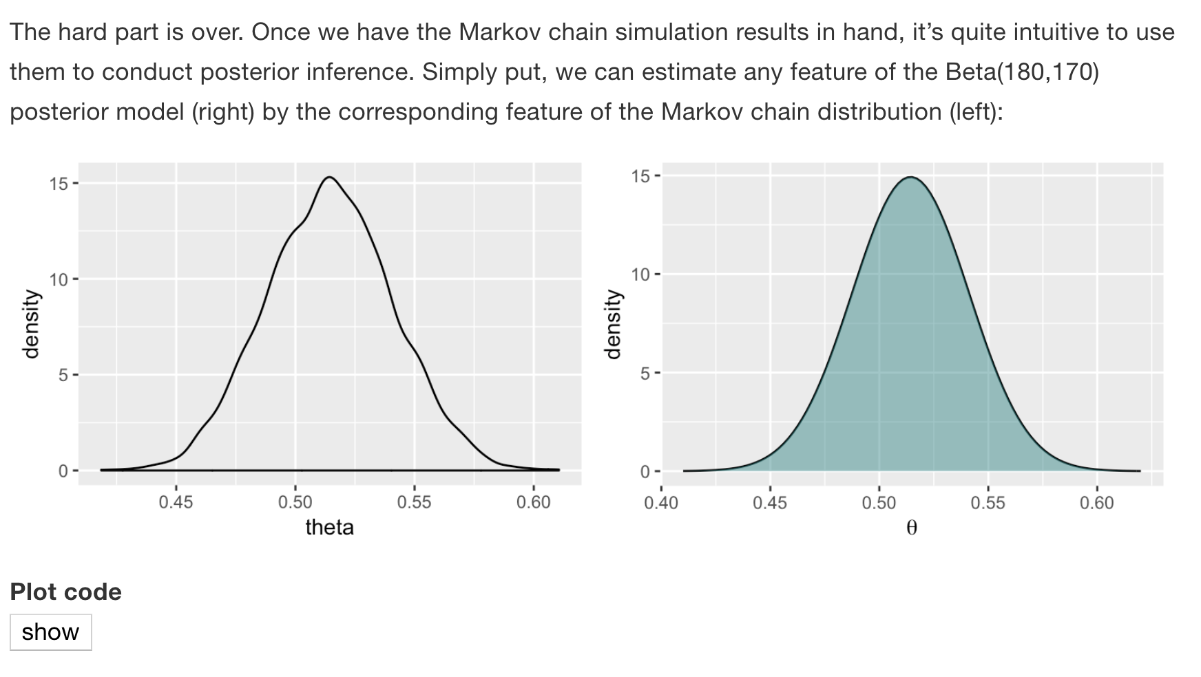
Stop and think: code folding

Slide 28
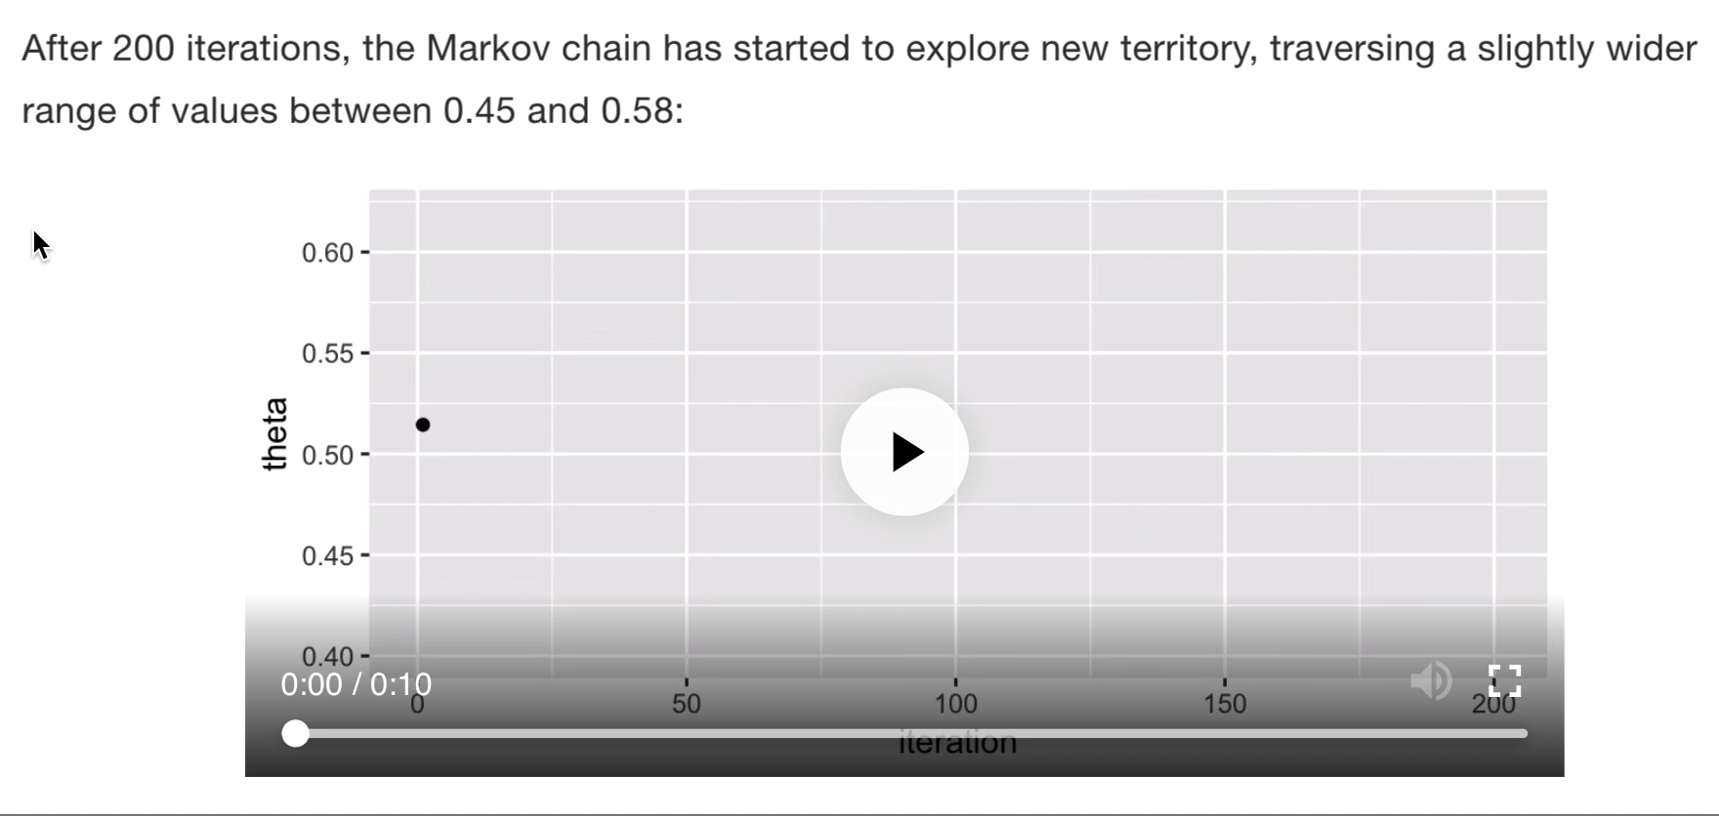
Experience: video & animation

Slide 29
DISTRIBUTE
reflect modern data science workflow

Slide 30

DISTRIBUTE
reflect modern data science workflow
reproducible
open-source
agile
+

Slide 31
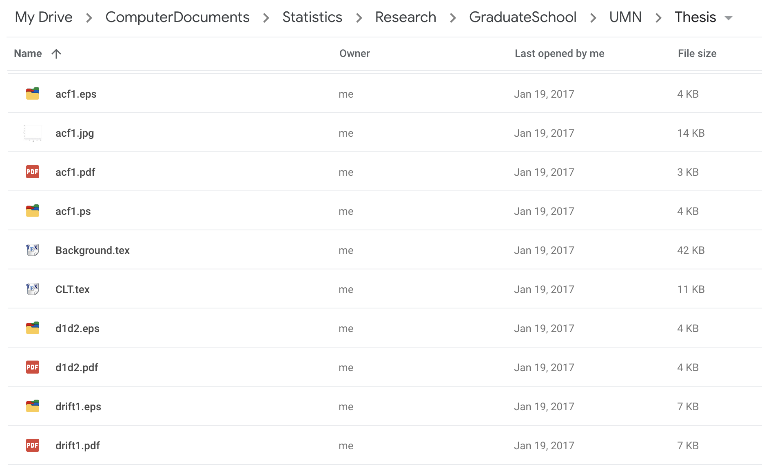
Non-reproducible

Slide 32
Reproducible
A recent fivethirtyeight.com article asked “What do men think it
means to be a man?” **Q: How much have you heard about the
#MeToo movement?**
```{r echo = FALSE}
# Load data
survey <- read.csv("https://raw.github...masculinity-survey.csv")
# Plot survey results
ggplot(survey, aes(x = Response, y = Percent)) +
geom_col() +
coord_flip()
```

Slide 33
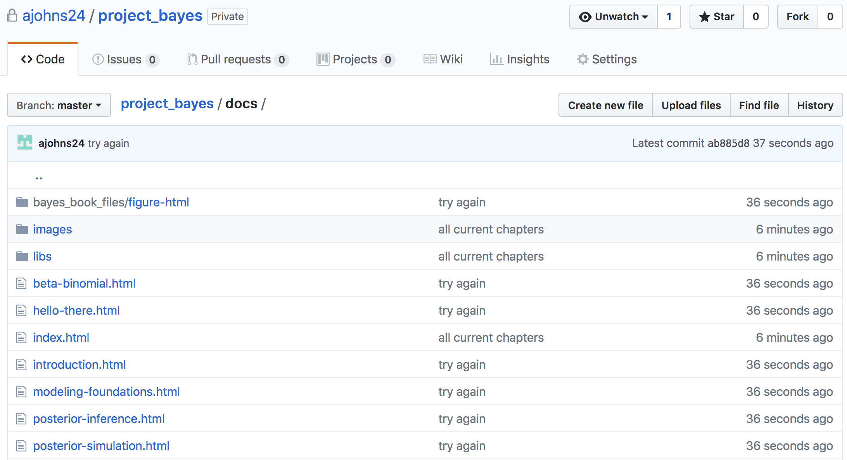
Distributing open-source materials on GitHub
X

Slide 34

Open-source: open access
https://mightywriters.org/book-donations__trashed/free-books-sign/

Slide 35
Open-source: open access, customizable
X

Slide 36
Open-source: open access, customizable
X

Slide 37
Open-source: open access, customizable
X

Slide 38
Open-source: open access, customizable
X
Add tailored example

Slide 39
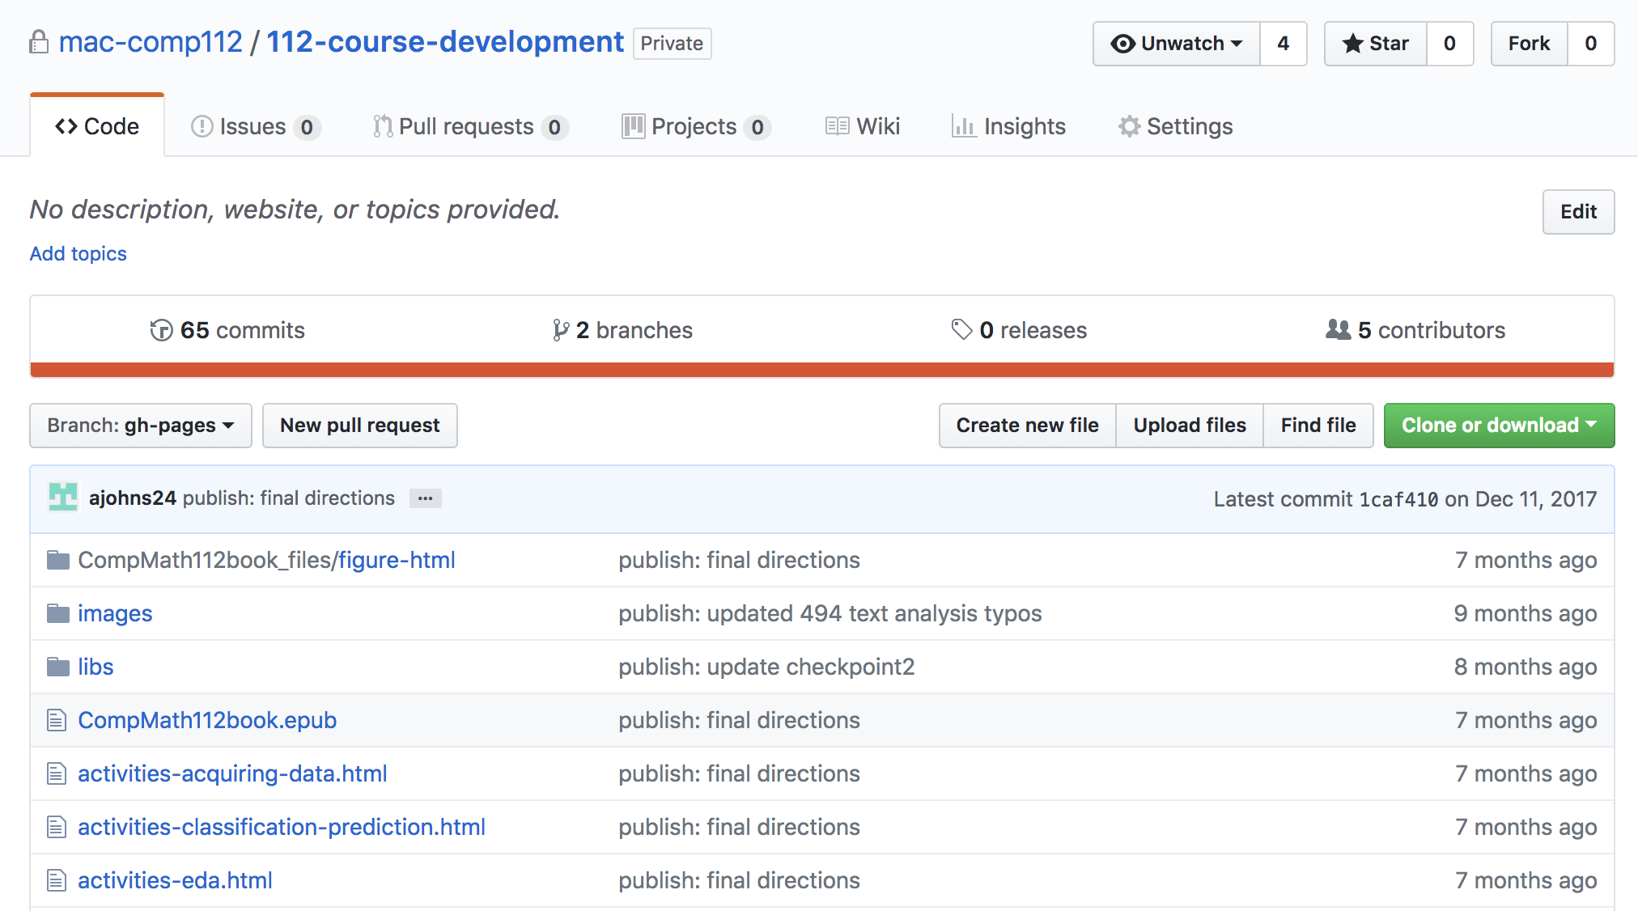
Open-source: open access, customizable, collaborative

Slide 40
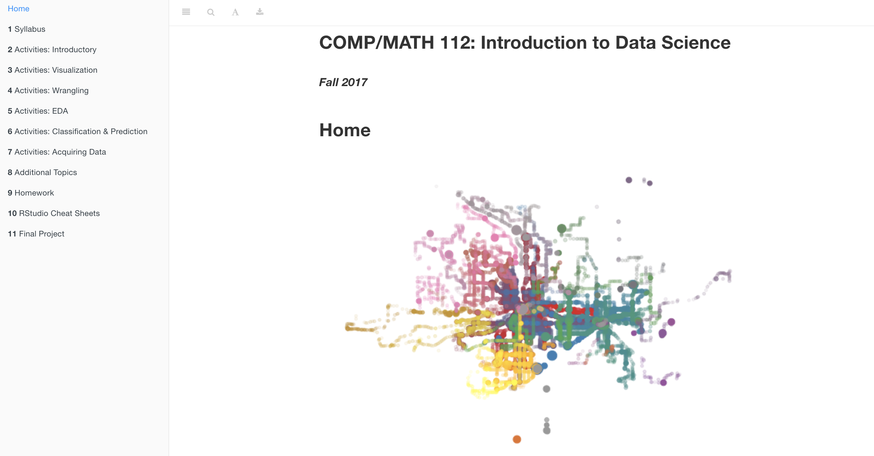
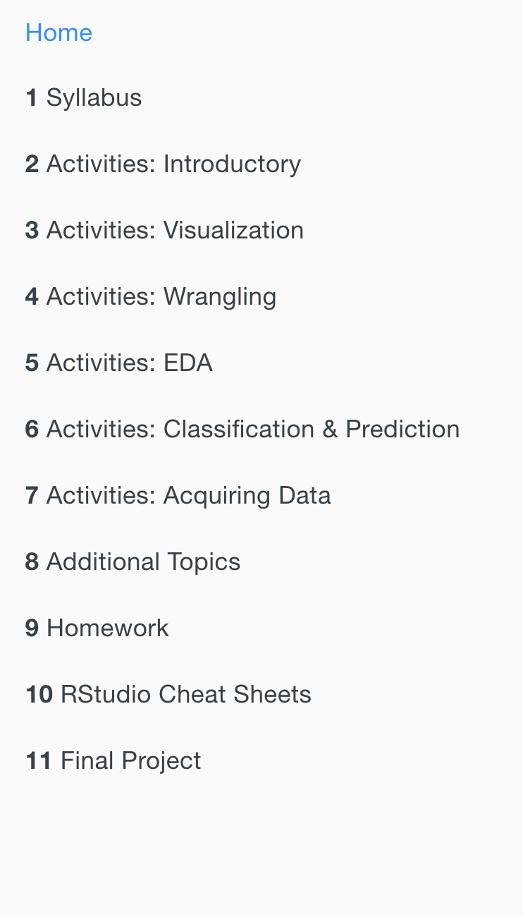
Open-source: open access, customizable, collaborative
Addona, Johnson, Kaplan, Sen, Shuman
https://mac-comp112.github.io/112-course-development/

Slide 41

versions not editions

Slide 42

Putting this all together...
+
align with current best practices in statistics education;
encourage readers to learn by doing;
reflect the modern data science workflow; and
look great.

Slide 43
ACTION ITEM:
Convert a single project (eg: book, notes, manual, diary) to
+

Slide 44
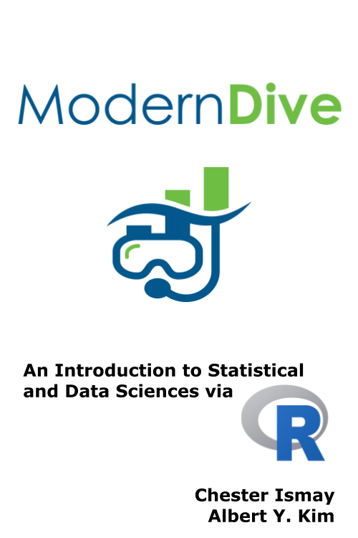
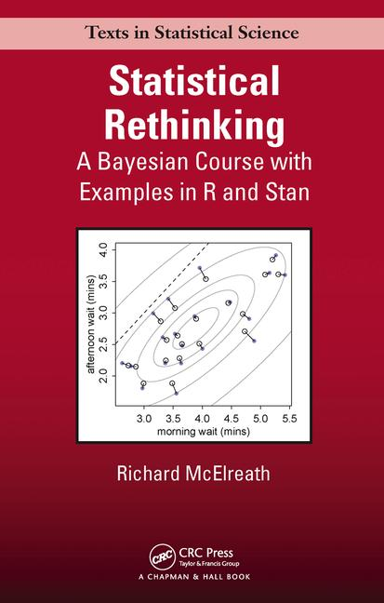
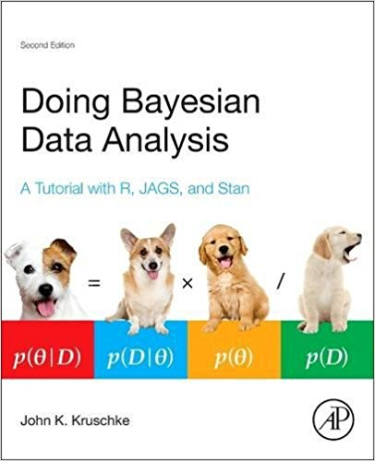
THANK YOU to some inspirations:

Slide 45
THANK YOU for listening
Contact:
ajohns24@macalester.edu
aliciajohnson78.weebly.com
github: ajohns24
Upcoming projects:
Rough bookdown sample: https://ajohns24.github.io/project_bayes/
DataCamp: Bayesian Modeling with RJAGS

